Slide 1

Product-focused
AI Software Engineer
Jinwoo Seol
Graduation
Date of Birth. January 7, 1999
Location. Seongnam-si, Gyeonggi-do, South Korea
Phone. (+82) 10-7611-2484
Email. tjfwlsdn17@gmail.com
Pohang University of Science and Technology (POSTECH)
B.S. in Life Science, Minor in Computer Engineering
Feb 2016 – Feb 2022
Work Experiences
Technical Skills
Selected Impact
OPTOLANE Technologies, Inc. | Software Engineer Oct 2022 – Present
Development of AI-based diagnostic and analysis systems
Software engineering for clinical and laboratory devices
Ownership of end-to-end AI deployment across clinical products
ML & DL & Computer Vision
Model design · Recognition · Performance Optimization
Frameworks & Libraries
PyTorch · TensorFlow
Programming Languages
Python · C/C++ · C#
Java · SQL
UI & Application Development
Qt · PySide6
Operating Systems
Linux · Windows
Secure System Design
Encryption · Secure Communication · Access Control
95% Accuracy
99.5% Accuracy
Clinical MSI Diagnosis
CGT Cell Analysis
2-10x Resolution
7+ Countries
Digital Melting Curve Interpolation
Production Deployment (include Johns Hopkins, US)
Early Experiences
Genexine – Analysis Team Intern
C-BIOMEX – R&D Intern
Korea Brain Research Institute (KBRI) – R&D Intern
Summary
Projects
Product-focused AI software engineer delivering production-grade medical AI systems.
AI-based MSI Diagnostic System (Clinical Collaboration)
AI-based Cell Recognition Model Development
→ View more projects

Slide 2


01
Clinical AI (Core Strength)
Digital Melting Analysis (MSI AI)
Cell Gene Therapy (CGT AI)
Selected
Projects
Overviews
02
Medical Device Software (Productization)
- LOAA-M / LOAA-E
03
Deep Learning Research (Foundation)
- Breast Cancel DL Project

Slide 3
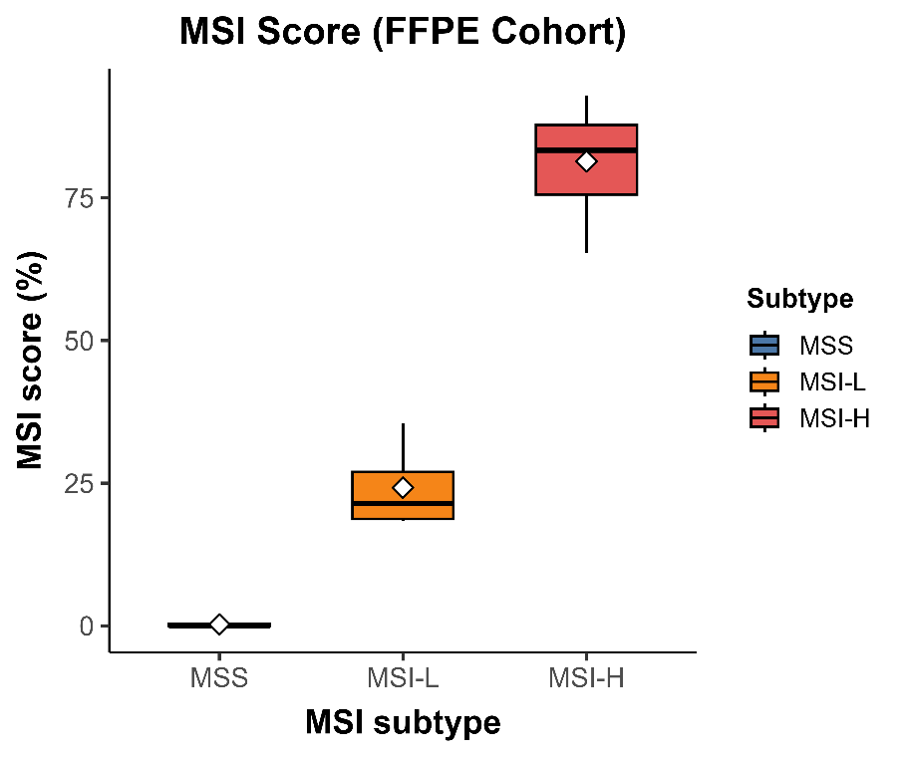

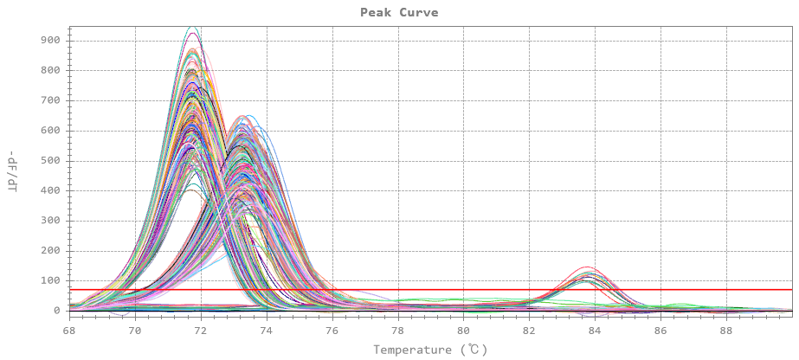
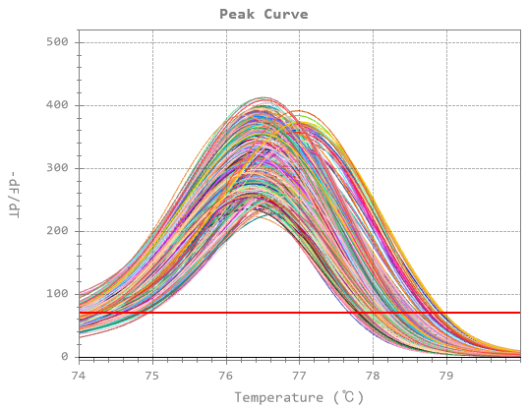

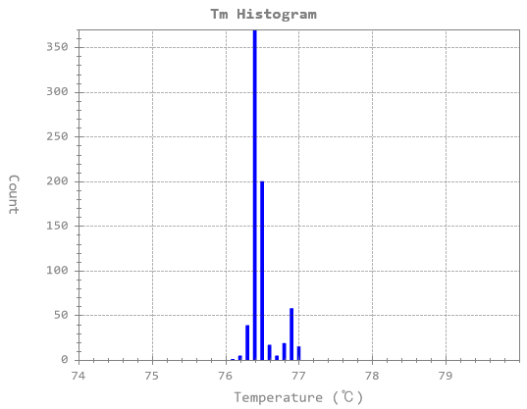
Digital Melting-Based MSI Prediction AI Software Design & System Architecture
Raw Digital Melting Data
AI Training & Prediction
MSI Scoring
Training cohort: n = 92
MSI High
Feature Extraction
Decision Threshold: 50%
Healthy group
10%
Oct 2024 – Present
MSI group
Early-Stage of MSI
MSI-Classifier
AI Training
MSI Low
Strategic Role
Decision Threshold: 10%
MSS
AI Engineer – Digital PCR & Melting Analysis
Owned the end-to-end design of an AI-based MSI prediction system using digital melting analysis
Architected the full pipeline from signal processing to clinical-grade AI inference
Led ultra-precise Tm calibration design for high-resolution MSI diagnostics
Processing + Resolution Enhancement
RandomForest
Classification
95%+
Classification Accuracy
MSS
MSI
AI Decision: Calls “MSI High” for clinical cases exceeding the decision threshold.
Technical Description
Designed an AI-driven digital melting analysis system for MSI prediction from high-density PCR fluorescence data
Integrated ML-based quality control, clustering, and noise-robust feature extraction for reliable clinical inference
Implemented ultra-precise Tm calibration techniques to significantly enhance diagnostic resolution and stability
Key Impact
Clinical MSI Prediction:
Achieved 95%+ accuracy on clinical samples using digital melting–based AI
Resolution Improvement:
Enhanced melting curve resolution by 2–10× via ultra-precise Tm calibration
Patented Core Technology:
Filed patents for key Tm analysis and calibration algorithms
Architectures & Tools
Python / ML: MSI classification, clustering, and quality control
Signal Processing: Noise reduction, curve normalization, feature extraction
Frameworks: PyTorch, TensorFlow, Scikit-learn
Research & Visualization: PyQt, Cursor AI

Slide 4
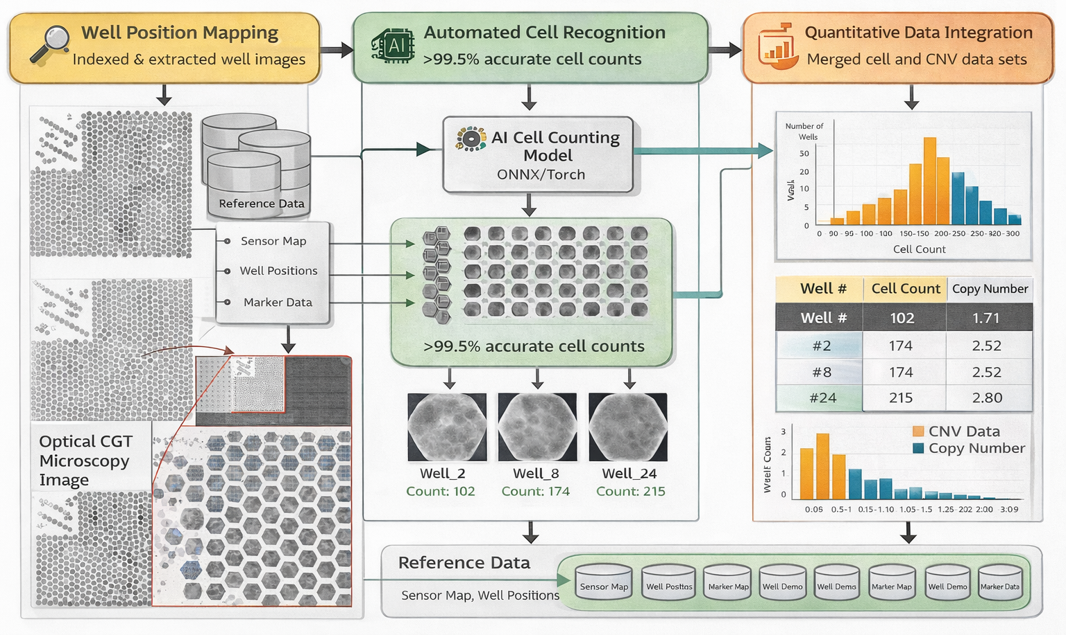
AI Cell Recognition System
Software Design & System Architecture
Well Count
Jun 2024 – Present
Cell Count
Strategic Role
Solo owner of an end-to-end AI system
Independently built an AI-driven CGT cell analysis system
Converted experimental workflows into an automated DL pipeline
Delivered a model-to-UI integrated solution
Well Count
Key Impact
System Validation:
Established a high-confidence AI cell recognition system (>99.5% accuracy)
Execution Ownership:
Delivered two production-ready prototypes within 2 months
Workflow Re-architecture:
Transformed manual CGT cell analysis into an automated pipeline
Technical Description
Developed a deep-learning–based model to automate microscopy image analysis in Cell & Gene Therapy (CGT).
The system performs high-accuracy cell recognition and quantitative analysis, reducing manual variability and enabling reproducible CGT data interpretation.
This approach establishes an efficient and scalable foundation for AI-assisted CGT analysis.
Architectures & Tools
PyTorch, TensorFlow: Core deep-learning cell recognition models
AI Pipeline: Integrated preprocessing, inference, and analysis into a single workflow
PyQt + Cursor AI: Built and iterated a UI-based CGT analysis software
Notes:
Renewal the image

Slide 5
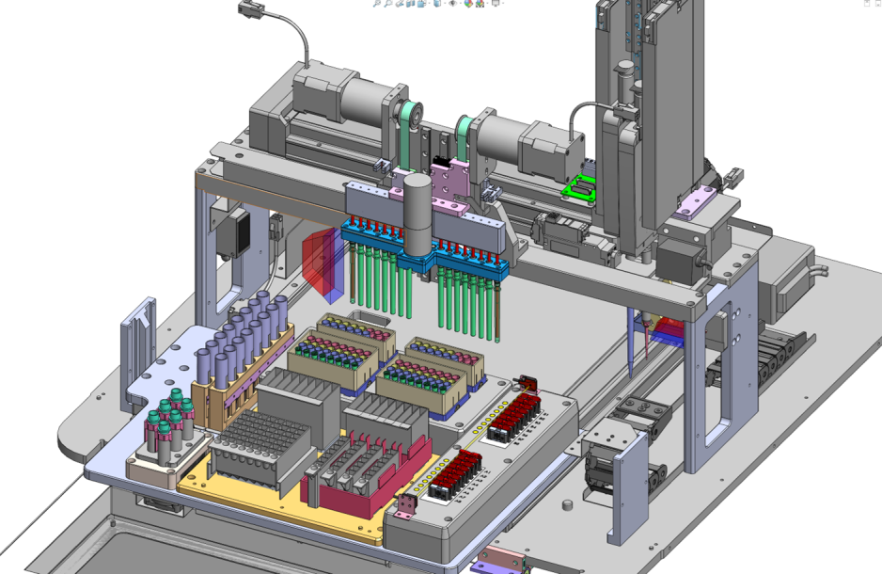
LOAA-E (Automated Nucleic Acid Extraction System)
Software Design & System Architecture
Sep 2023 – May 2024 (9 months)
Strategic Role
Lead Software Planner & Architect
Bridged Clinical Needs to Technical Software Specifications
Optimized Workflow for Production-Ready Medical Devices
Key Impact
One-Touch Solution:
Designed an intuitive Android-based interface for complex extraction cycles.
Error-Free System:
Integrated Barcode/QR recognition for automated consumable verification.
Global Readiness:
Authored technical documentation for CE and MFDS (KFDA) certification.
Technical Summary
Objective:
Abstracted complex biological protocols into a seamless, automated software workflow for clinical environments.
System Architecture:
Designed core logic and state-machine scenarios, transitioning a conceptual prototype into a production-ready medical device.
User Experience:
Implemented a "One-Touch" Android-based interface with integrated QR/barcode recognition to eliminate human error.
Global Compliance:
Ensured clinical reliability and global deployment readiness by authoring technical specifications for CE and MFDS certifications.
Architectures & Tools
StarUML: Logic flow & System activity diagrams.
Draw.io: User interaction & Edge-case use case mapping.
Android/Java: Production-grade system control.

Slide 6
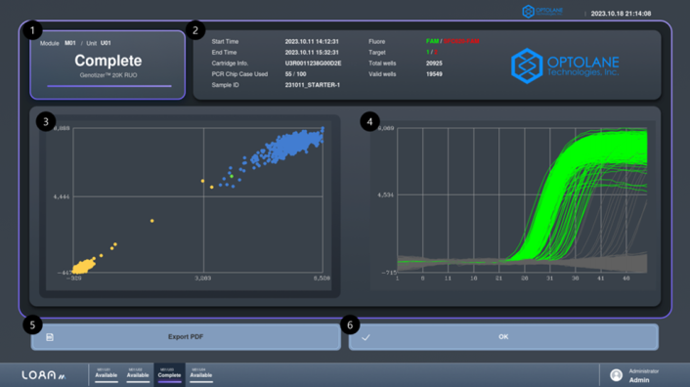
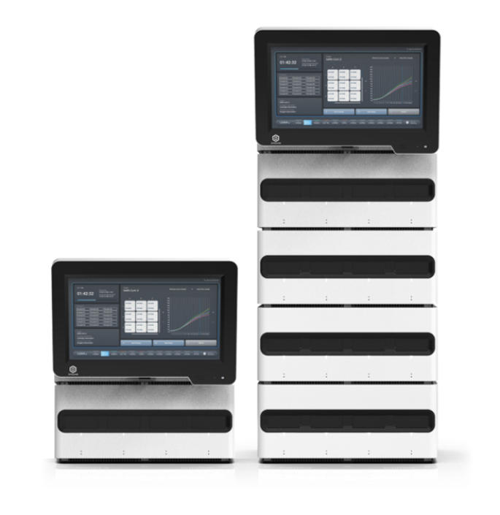
LOAA-M (In-vitro Diagnostic Medical Device System)
Software Development
Oct 2022 – Aug 2023 (9 months)
Strategic Role
Core Software Engineer – Commercial Diagnostic PCR Platform
Built cross-platform diagnostic software (Linux, Windows)
Implemented cloud connectivity and medical-grade security
Delivered production-ready software for global deployment
Technical Description
LOAA-M is a digital real-time PCR diagnostic software system for analyzing DNA and RNA targets in clinical and research settings.
The system processes large-scale optical fluorescence data in real time, visualizing amplification curves to enable reliable automated diagnostic interpretation.
A cloud-connected and security-embedded architecture supports real-time monitoring and result review while ensuring secure handling of clinical diagnostic data.
Key Impact
Global Commercial Deployment
Production diagnostic software deployed in 7+ countries, including Johns Hopkins (USA)
Cloud Monitoring
Real-time experiment and result visibility via AWS-connected web services
Medical Cybersecurity
File encryption, secure communication and access control for secure clinical data handling
Architectures & Tools
C++ / Qt: Diagnostic UI and analysis logic on Linux and Windows platforms
Java / AWS: Cloud-connected diagnostic data synchronization on Windows
MariaDB / SQL: Diagnostic data management and performance optimization
https://optolane.com/ko/analyzer_02/
Notes:
고화질 이미지로 변경 필요

Slide 7
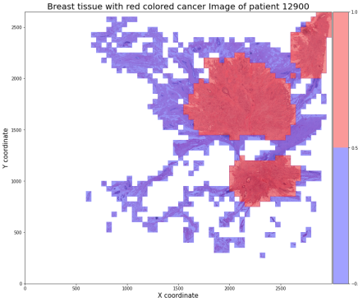
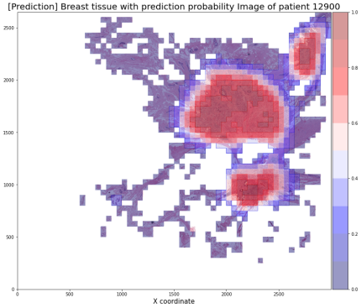

IDC Localization Model
Deep Learning-Based
Breast Histopathology Image Analysis
Labeled IDC region
Predicted IDC region
Individual Research Project
Mar 2022 – Jun 2022
Research Objective
To develop a deep learning model capable of predicting invasive ductal carcinoma (IDC) from breast tissue patch images
To investigate methods for improving spatial coherence and targeting accuracy of IDC predictions beyond isolated patch-level inference
Blue: non-IDC
Red: IDC
Core Technical Insight
An EfficientNet-B2–based model (FC 256–128–64) achieved 93% training accuracy and 86% test accuracy, establishing a strong classification baseline
Patch-level inference produced fragmented IDC probability maps, limiting localization interpretability
Probability map refinement and smoothing improved test accuracy from 86% to 93% and enabled clearer IDC localization
Project Context
This project was an early-stage exploration into applying deep learning to breast histopathology image analysis.
The focus was not only on IDC classification accuracy, but on understanding how patch-level predictions could be transformed into spatially meaningful cancer localization, highlighting challenges in real-world medical image interpretation.
Architectures & Tools
Python / Data Processing: Model development and patch-level data handling
TensorFlow / Scikit-learn: Model training, inference, and evaluation
Matplotlib / Seaborn: Visualization of probability maps and analysis results
Detailed information
https://ursus-maritimus.tistory.com/150?category=1005488

Slide 8

THANK YOU!
CONTACT
jtjfwlsdn17@gmail.com
(82+) 10-7611-2484

